Slide 1
Nature’s Algorithms
Using Biology to Solve Complex Problems

Slide 2
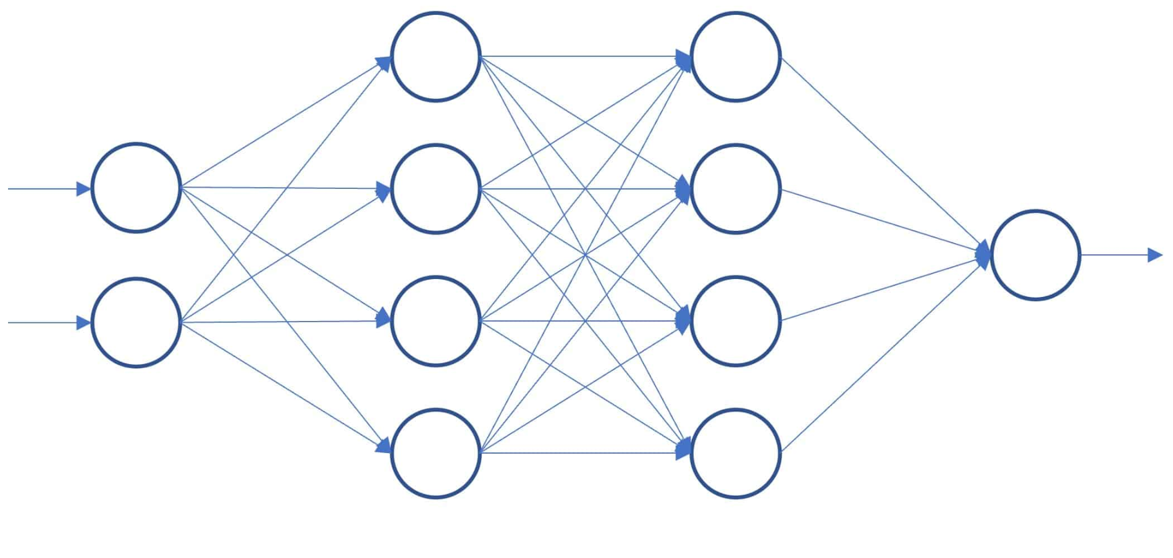
Neural Networks
Inspired by neurons
Trainable
Adaptable for many tasks
Foundation of modern AI
Input
Hidden
Hidden
Output

Slide 3
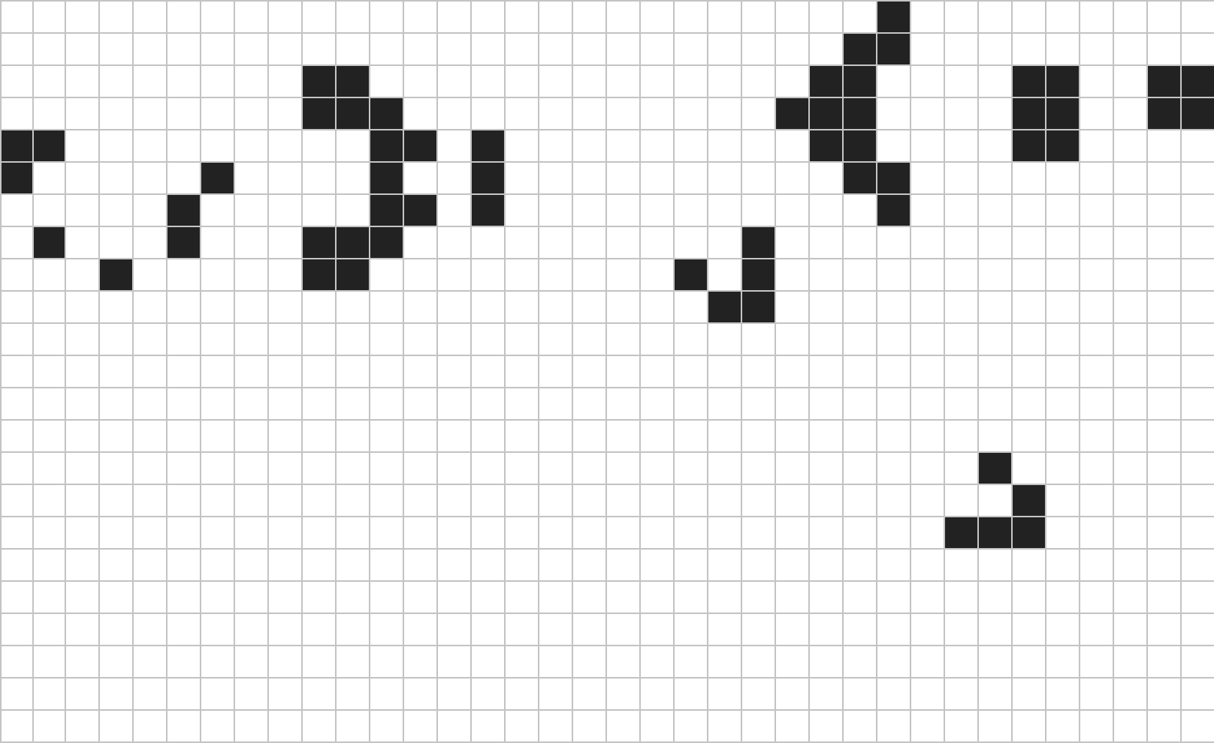
Emergent Behavior
Individual agents follow simple rules
Decentralized decision making
Interactions produce complex behaviors
Example: Cellular Automata (Conway’s Game of Life)

Slide 4
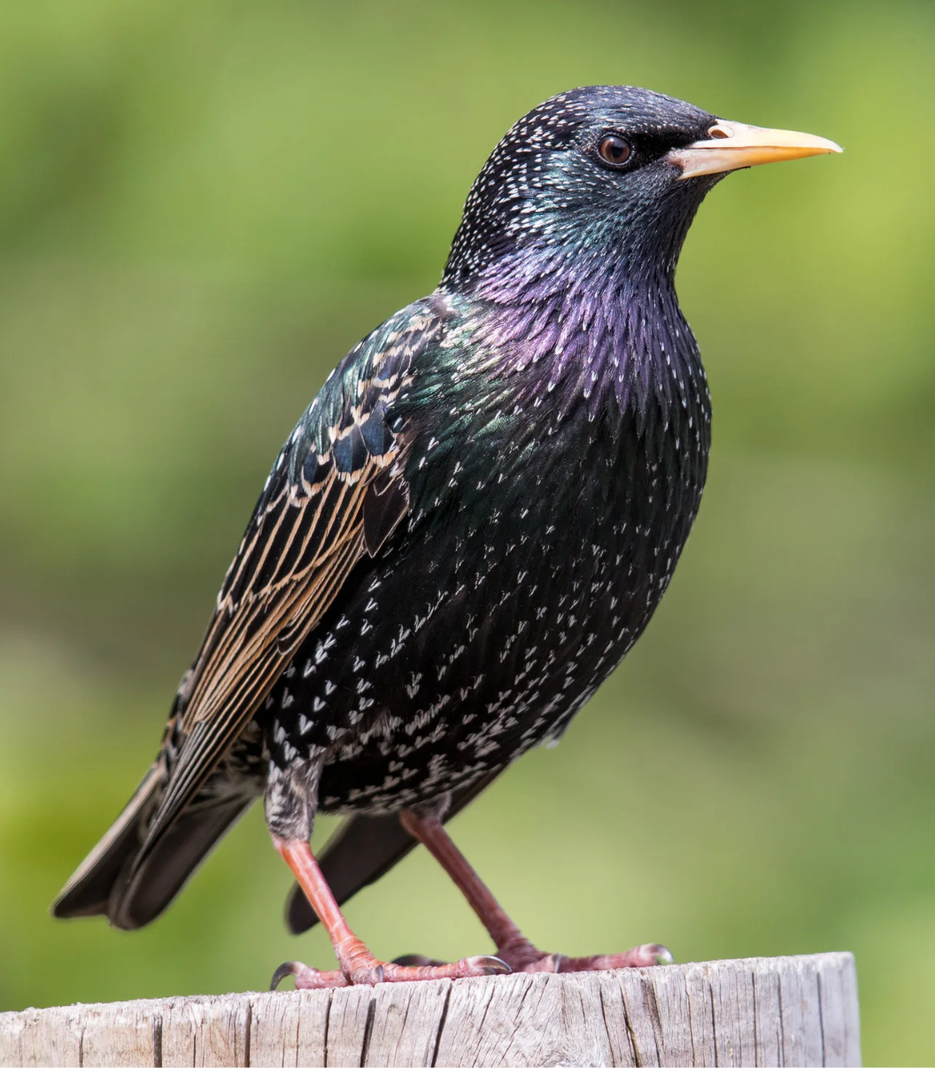
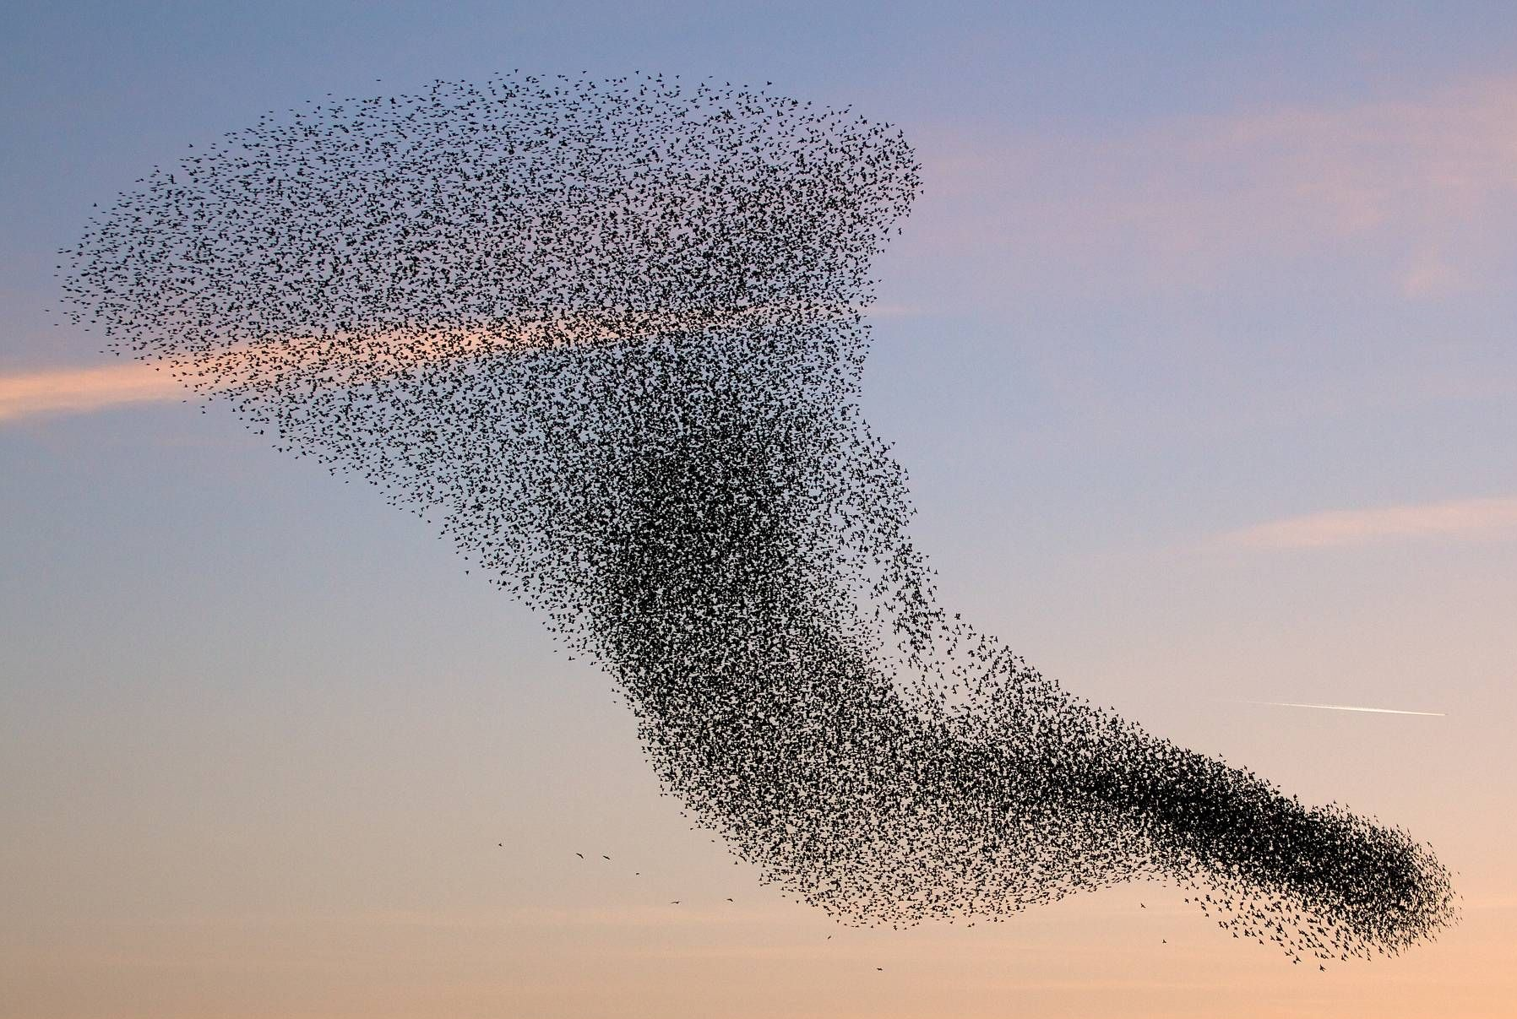
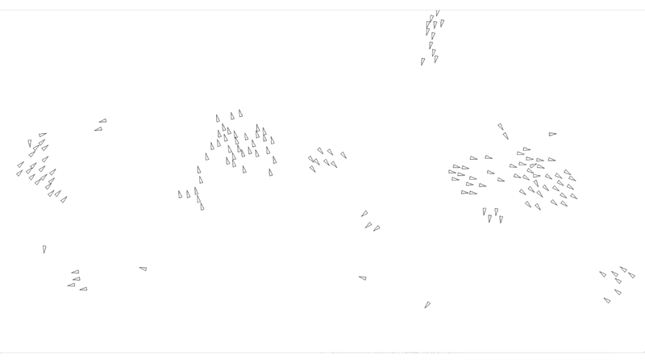
Boids
Inspired by bird flocks
Each agent follows three rules:
  Separation
  Alignment
  Cohesion
Flocking behavior emerges
Applications
Animation
Swarm Robotics

Slide 5
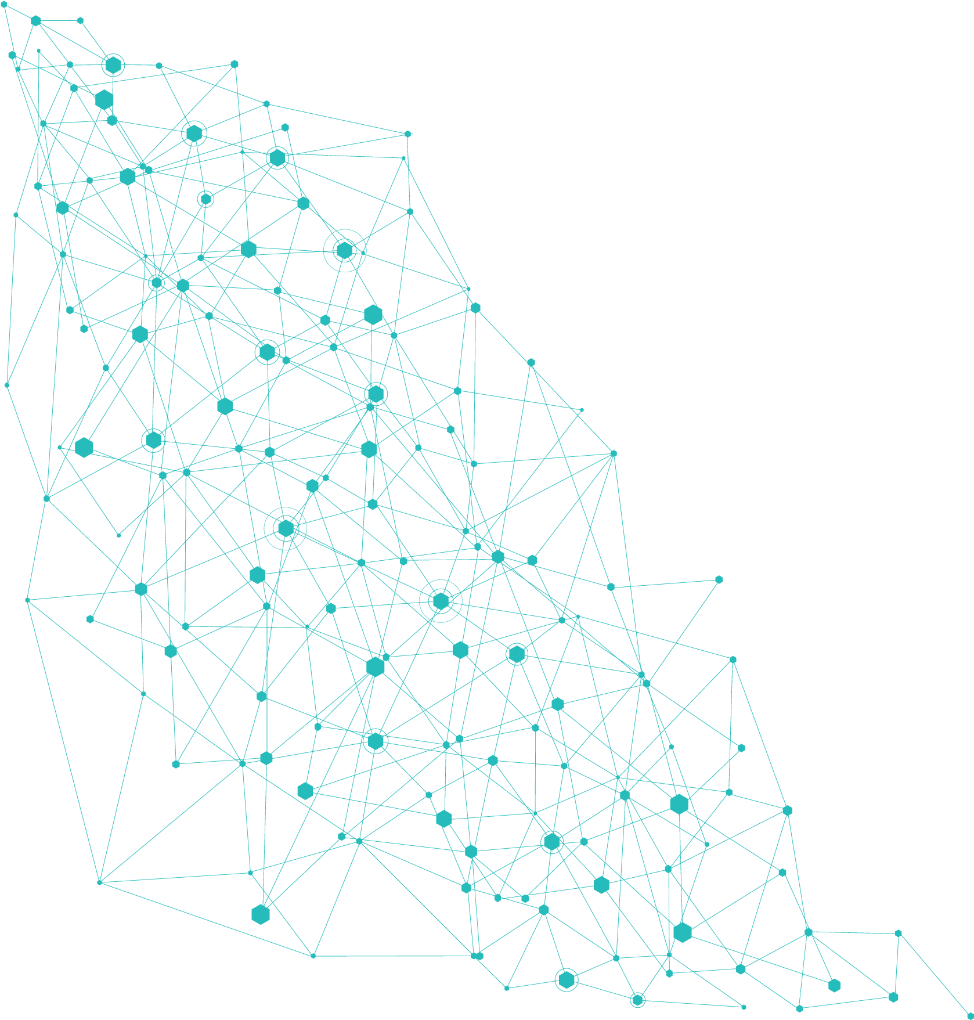
My Project
Goal:
Create a system that is able to create and optimize a network to efficiently connect nodes.
Requirements:
Maintain connectivity between all nodes
Minimize total path length (Cost)
Minimize cost to get from one node to any other node using limited redundancy
Practical Applications:
Communication Networks
Logistics Infrastructure
Urban Planning of Utilities

Slide 6
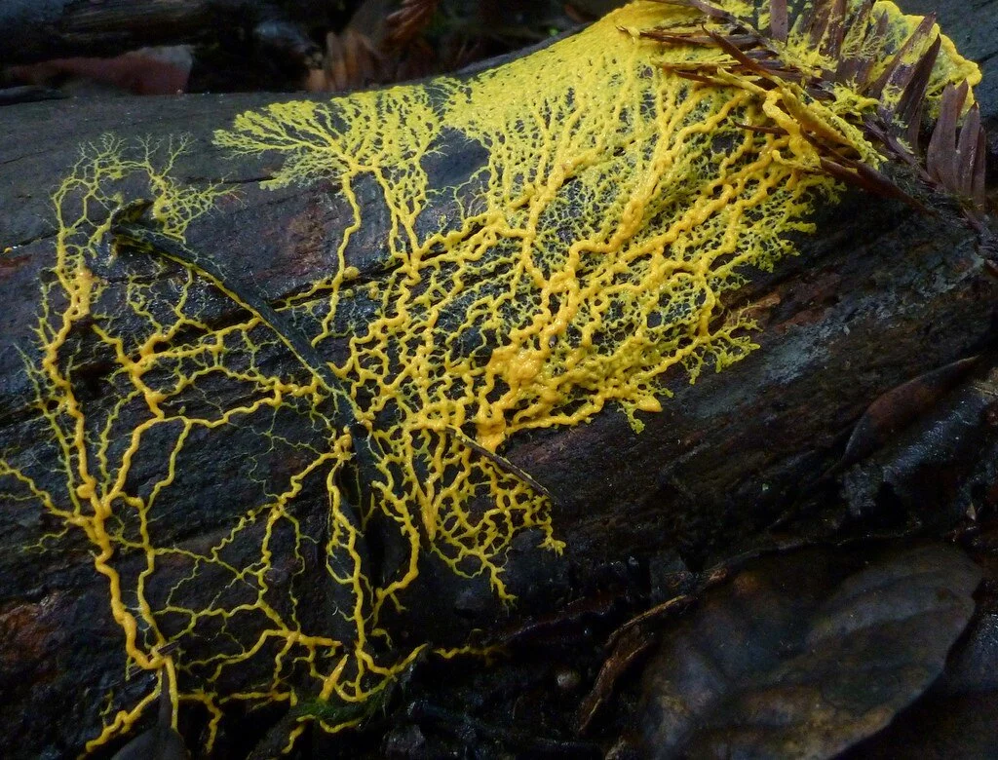
Slime Mold
(Physarum polycephalum)
Among the largest single celled organisms in the world
No brain or nervous system
Key Behaviors
Grows to find food
Able to reinforce efficient paths to food
Retracts unused or inefficient connections
Avoids areas with bright light if possible

Slide 7
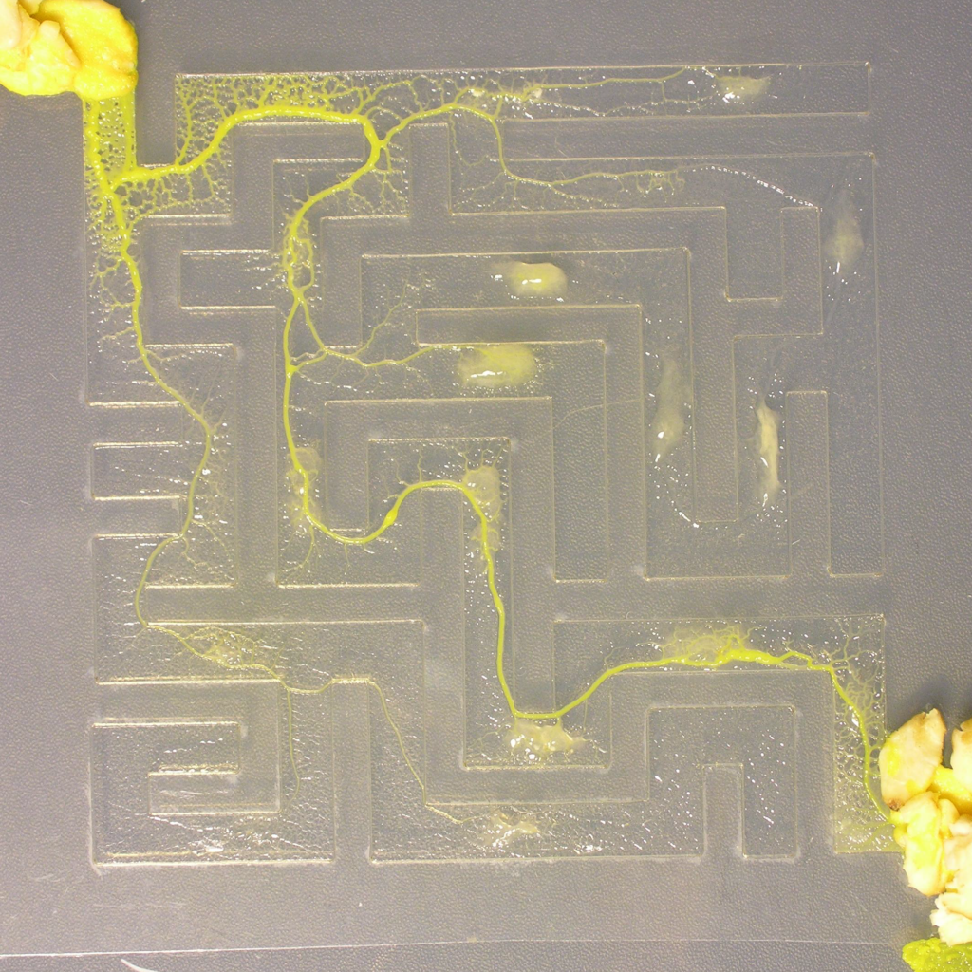
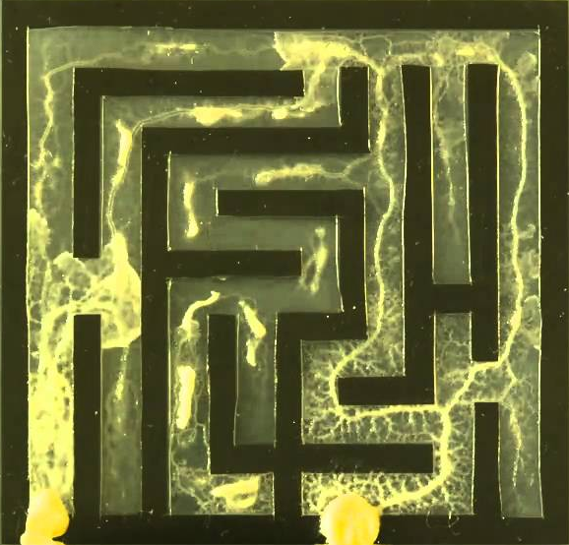
Slime Mold Solving Mazes

Slide 8
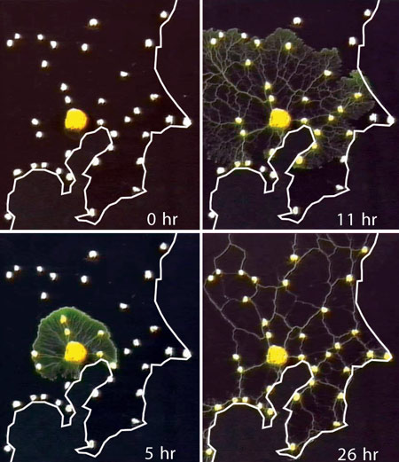
Tokyo Railway Experiment
Food was placed on a map at each train station.
Light was projected onto the map to deter the mold from growing in certain areas (Oceans, Mountains).
A sample of slime mold was introduced onto the map, starting on Tokyo.
The slime mold grew until it had connected all of the food pieces.
An experiment was conducted using a real specimen of slime mold to recreate the railway network around Tokyo.

Slide 9
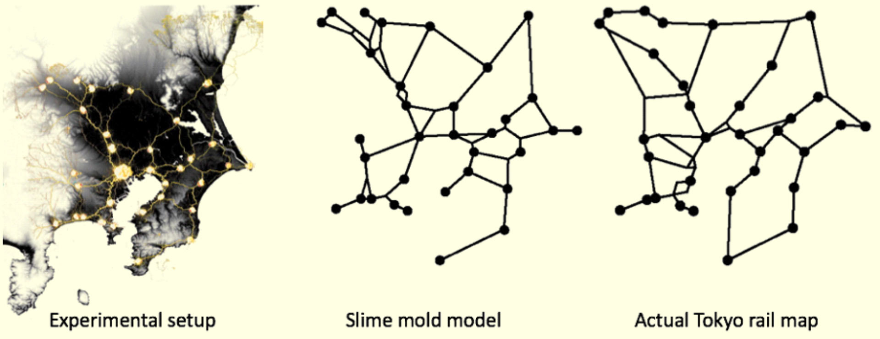
Real Slime Mold Result

Slide 10
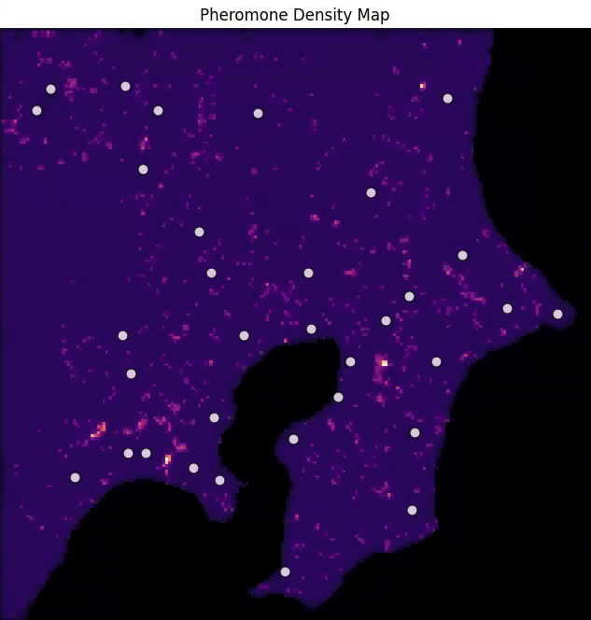
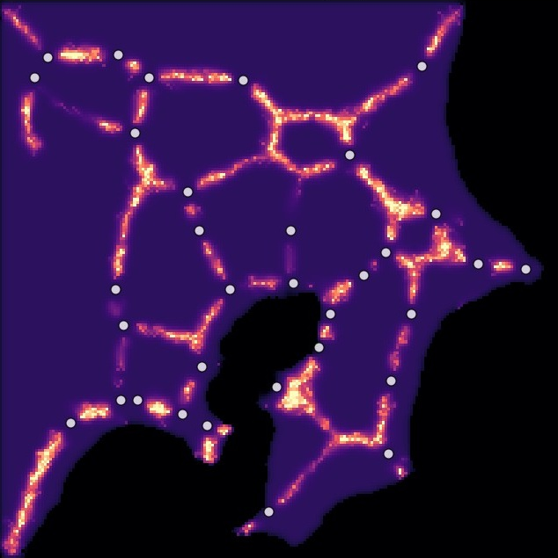
Simulated Slime Mold Result

Slide 11
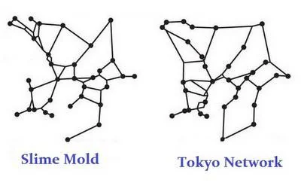
Comparison
Actual Tokyo Rail Map
Real Slime Mold Model
Simulated Slime Mold Model

Slide 12

Thank You

